Slide 1
The Maximum Clique Problem
Alyssa i mean Angela i mean Alyssa Newman

Slide 2
Recall the problem
The Maximum Clique Problem is the problem of finding the maximum clique, or complete subgraph, of a graph.
The polytope of this problem can be defined by its vertices that are the incidence vectors of any cliques that appear in the graph.
The greedy algorithm starts with any vertex and iteratively adds any other vertex such that adding that vertex maintains the subgraph being a clique.
3
1
2

Slide 3
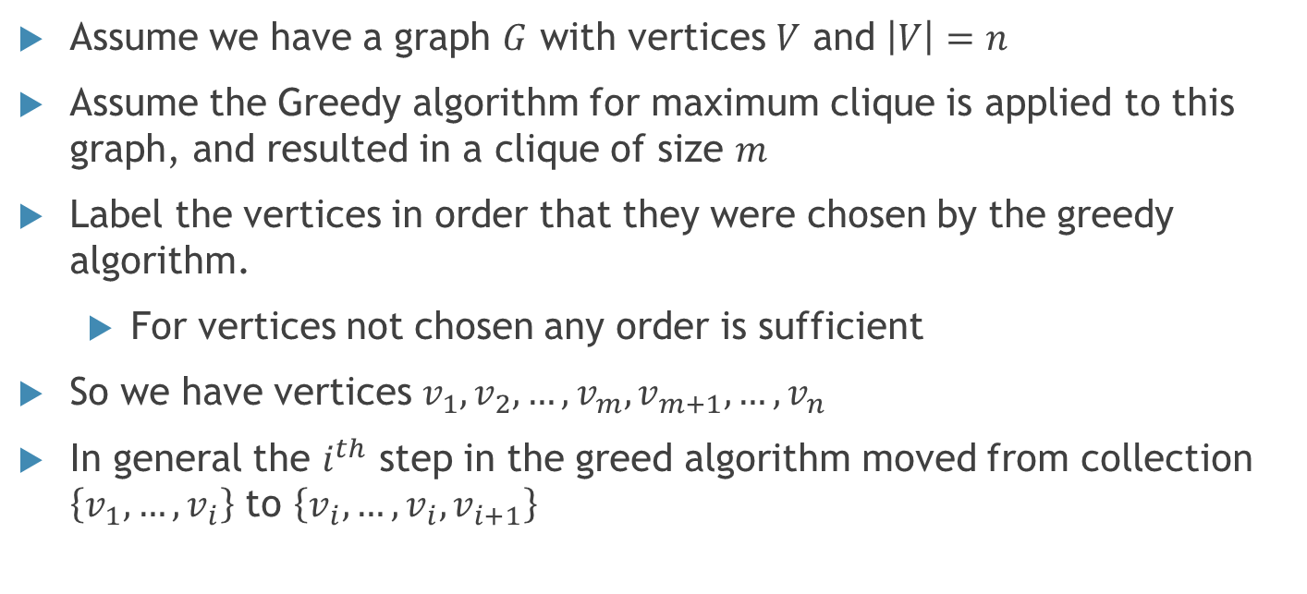
General Greedy on a Graph
Assume we have a graph $G$ with vertices $V$ and $\left|V\right|=n$
Assume the Greedy algorithm for maximum clique is applied to this graph, and resulted in a clique of size $m$
Label the vertices in order that they were chosen by the greedy algorithm.
For vertices not chosen any order is sufficient
So we have vertices $v_{1},v_{2},…,v_{m}, v_{m+1},…,v_{n}$
In general the $i^{th}$ step in the greed algorithm moved from collection $\left\{v_{1},…,v_{i}\right\}$ to $\left\{v_{i},…,v_{i},v_{i+1}\right\}$

Slide 4

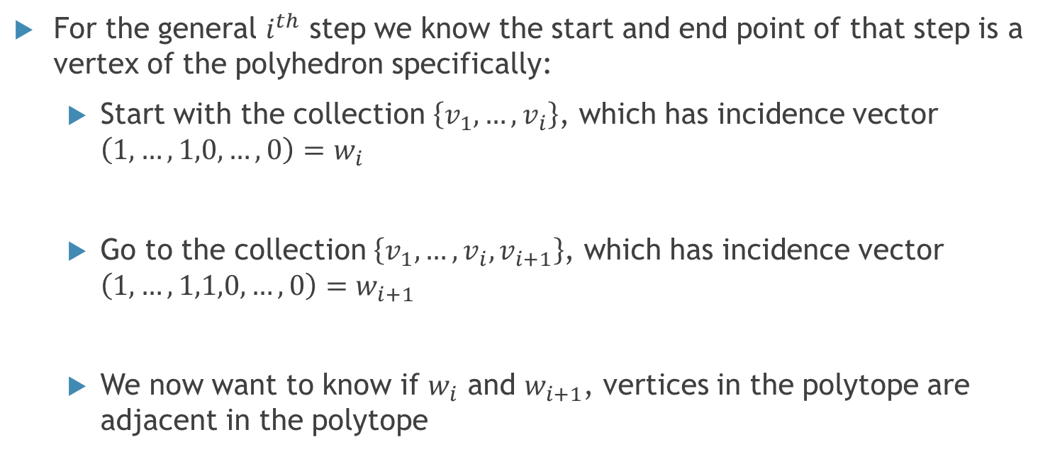



A closer look at a step in the greedy algorithm
For the general $i^{th}$ step we know the start and end point of that step is a vertex of the polyhedron specifically:
Start with the collection $\left\{v_{1},…,v_{i}\right\}$, which has incidence vector $\left(1,…,1,0,…,0\right)=w_{i}$
Go to the collection $\left\{v_{1},…,v_{i},v_{i+1}\right\}$, which has incidence vector $\left(1,…,1,1,0,…,0\right)=w_{i+1}$
We now want to know if $w_{i}$ and $w_{i+1}$, vertices in the polytope are adjacent in the polytope
$$i$$
$$m−i$$
$$i+1$$
$$m−i−1$$

Slide 5
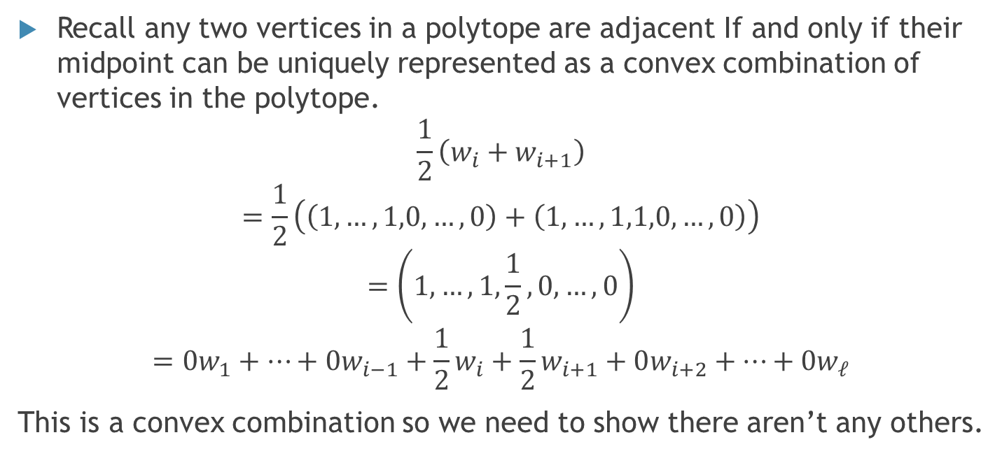
Determine if those two vertices are adjacent
Recall any two vertices in a polytope are adjacent If and only if their midpoint can be uniquely represented as a convex combination of vertices in the polytope.
$$\frac{1}{2}\left(w_{i}+w_{i+1}\right)$$
$$=\frac{1}{2}\left(\left(1,…,1,0,…,0\right)+\left(1,…,1,1,0,…,0\right)\right)$$
$$=\left(1,…,1,\frac{1}{2},0,…,0\right)$$
$$=0w_{1}+…+0w_{i−1}+\frac{1}{2}w_{i}+\frac{1}{2}w_{i+1}+0w_{i+2}+…+0w_{ℓ}$$
This is a convex combination so we need to show there aren’t any others.

Slide 6
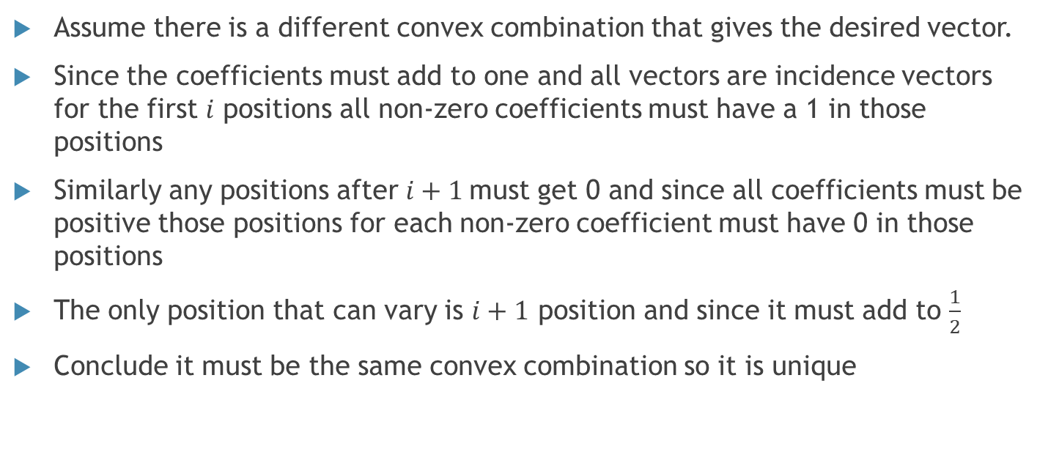
Proof outline
Assume there is a different convex combination that gives the desired vector.
Since the coefficients must add to one and all vectors are incidence vectors for the first $i$ positions all non-zero coefficients must have a 1 in those positions
Similarly any positions after $i+1$must get 0 and since all coefficients must be positive those positions for each non-zero coefficient must have 0 in those positions
The only position that can vary is $i+1$ position and since it must add to $\frac{1}{2}$
Conclude it must be the same convex combination so it is unique

Slide 7
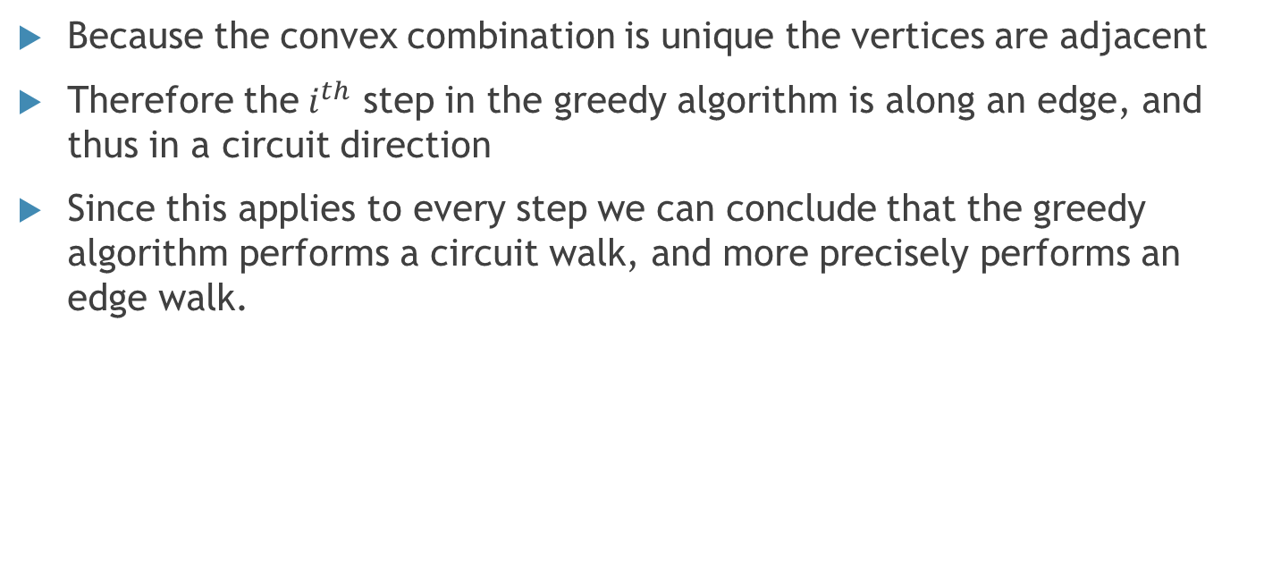
Conclusion- The greedy algorithm performs a circuit walk
Because the convex combination is unique the vertices are adjacent
Therefore the$i^{th}$ step in the greedy algorithm is along an edge, and thus in a circuit direction
Since this applies to every step we can conclude that the greedy algorithm performs a circuit walk, and more precisely performs an edge walk.

Slide 8
References
Korte, Bernhard, and Jens Vygen. Combinatorial Optimization: Theory and Algorithms. Springer, 2018.
De Simone, Caterina, and Mosca, Raffaele. Stable set and clique polytopes of (P5,gem)-free graphs. Discrete Mathematics, Volume 307, Issue 22,2007,Pages 2661-2670,ISSN 0012-365X, https://doi.org/10.1016/j.disc.2007.01.010.

